Slide 1
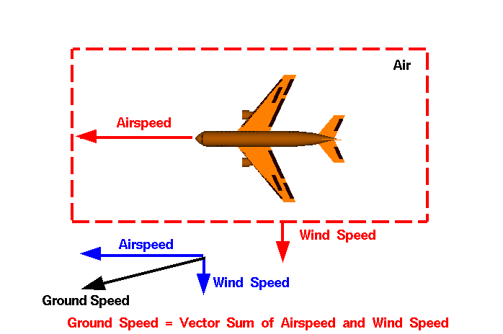
Frames of Reference and
Relative Velocity

Slide 2
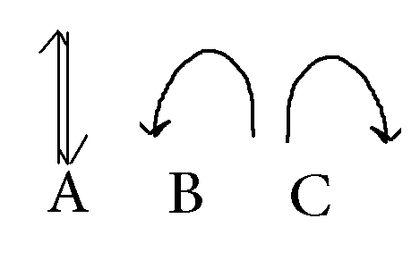


1.A boy on a skateboard, moving at a constant velocity forward, tosses a ball straight up in the air. Which of the following diagrams correctly shows the ball’s path from the perspective of THE BOY?
Forward
[Default]
[MC Any]
[MC All]

Slide 3
2. A boy on a skateboard, moving at a constant velocity forward, tosses a ball straight up in the air. Which of the following diagrams correctly shows the ball’s path from the perspective of a person standing on the ground?
Forward
[Default]
[MC Any]
[MC All]

Slide 4
3. A person is walking forward at 5.0 km/h on a train travelling at 42.0 km/h [East]. What is the person’s velocity relative to the ground?
42.0 km/h [East]
37.0 km/h [West]
47.0 km/h [East]
47.0 km/h [West]
[Default]
[MC Any]
[MC All]

Slide 5
4. A person is walking backwards at 3.0 km/h on a train travelling at 50.0 km/h [North]. What is the person’s velocity relative to the ground?
47.0 km/h [North]
53.0 km/h [North]
50.0 km/h [North]
47.0 km/h [South]
[Default]
[MC Any]
[MC All]

Slide 6
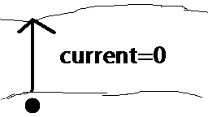
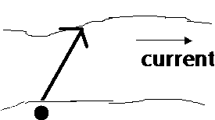
5. On two different days a swimmer wishes to cross a stream. On Day 1, the stream is moving so slowly the water is essentially at rest. On Day 2, the Hydro Dam has opened the gates upstream and the current is much faster. This affects the swimmer’s path as shown below. Which crossing takes the least time?
Day 1
Day 2
Both crossings take the same time
You can’t tell without knowing the speed of the current.
[Default]
[MC Any]
[MC All]

Slide 7
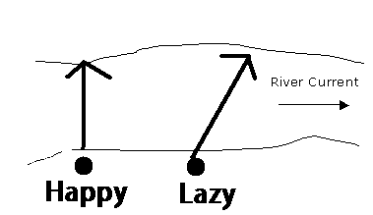

6. Two swimmers, Happy and Lazy, have an urgent desire to cross a moving river. Happy decides to compensate for the current by heading northwest so that his resultant path takes him directly across the river. Lazy decides to go with the flow and points north but lands downstream of where he started. If both swim at the same speed relative to water, who makes it across the river first?
They arrive at the same time.
Happy arrives first.
Lazy arrives first.
It’s impossible to tell without knowing their speeds and the current speed.
[Default]
[MC Any]
[MC All]

Slide 8
Frames of Reference
Frames of reference video....

